Slide 1
The dual link between time and discourse shaping the political response to the COVID-19 crisis. An analytical framework integrating narrative analysis within a Discourse-Historical Approach.
Lydie Denis – PhD candidate UCLouvain, Brussels
DiscourseNet x ALED conference 25-28/07/2023
lydie.denis@uclouvain.be

Slide 2
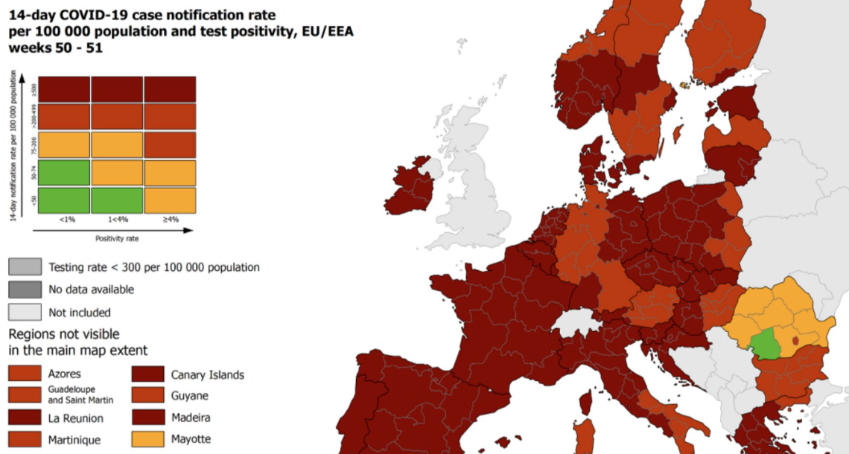
Plan
Context
Research Objective
Analytical Framework
Case analysis
Conclusion
Source: ECDC

Slide 3
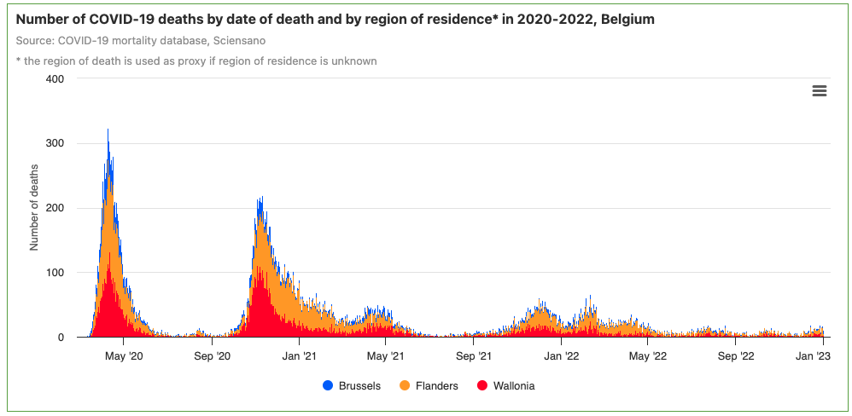
Temporality and time management of the crisis
Link between the COVID-19 crisis and its temporality:
duration,
cyclicity (waves),
urgency VS waiting,
« change » VS « continuity » (Driessens, 2023),
the « new normal » (Krzyżanowski et al., 2023).
https://www.healthybelgium.be/en/health-status/covid-19-crisis/covid-19-mortality

Slide 4
Temporality and time management of the crisis
Link between the COVID-19 crisis and its temporality: duration, cyclicity (waves), urgency VS waiting, « change » VS « continuity » (Driessens, 2023), the « new normal » (Krzyżanowski et al., 2023).
Time of the virus (epidemiological)
Time of scientific knowledge (Harrison et al. (2022) on vaccine development)
Time of political « decision making » (Boin et al., 2013; 2021)
https://www.healthybelgium.be/en/health-status/covid-19-crisis/covid-19-mortality

Slide 5
Temporality and time management of the crisis
Link between the COVID-19 crisis and its temporality: duration, cyclicity (waves), urgency VS waiting, « change » VS « continuity » (Driessens, 2023), the « new normal » (Krzyżanowski et al., 2023).
Time of the virus (epidemiological)
Time of scientific knowledge (Harrison et al. (2022) on vaccine development)
Time of political « decision-making » (Boin et al., 2013; 2021)
« (…) timing itself is also a social practice – an integrative practice, vital for the coherence of social life, for holding together most, if not all social practices of a society. Elias (1992) (…) described the history of what we would now call time management as a history in which time has been parceled up in ever smaller units, and in which the balance gradually moved from natural synchronization to arbitrary decisions (and hence human power) (…)» Van Leeuwen (2005)
https://www.healthybelgium.be/en/health-status/covid-19-crisis/covid-19-mortality

Slide 6
Time and discourse
Research objective: study the evolution of discourses on time in the decision-making process of the crisis.
The concepts of time, temporality (Robb, 2020) & timing (Van Leeuwen, 2005)
Dual vision of time in discourse studies:
The diachronic aspect
Raupp (2022), for instance, highlighted the importance of taking into account the evolutions of the Covid-19 crisis communication over time when studying discourse of political leaders. See also Wodak (e.g. 2015; 2011)
2) The elaboration of time as discursive resources
« representing and regulating the timing of social practices » (Van Leeuwen, 2005)
Conveying the experience of actors (De Fina, 2018; 2003 Carcassonne & Servel, 2009)
Creating a meaningful lived/human time (Doury & Naccuchio, 2019; Nahon-Serfaty, 2015; Ricoeur, 1983)

Slide 7
Analytical framework: linking the DHA & Narrative analysis
1) The Discourse-Historical Approach (DHA)
Developed mainly by Wodak (2015; 2022; Wodak & Rheindorf, 2022) & Reisigl (2017; Wodak & Reisigl, 2016 in Martin)
Focus on the historical dimension of discourse “by exploring the ways particular genres of discourse are subject to diachronic change” (Wodak, 2015) reproducing ideologies and power relationships. Discourse is not taken as a close unit but interpreted as a dynamic entity. (Wodak, 2015)
2) Narrative analysis
as developed by De Fina (2022; 2003; 2008); Forchtner (2021)
Allow to organize the temporal experience of actors in meaningful ways (McKibben & Breheny, 2023; Carcassonne & Servel, 2009; Schütz (1987)) and carry a chronological aspect that structures events (Carcassonne & Servel, 2009; Ricoeur, 1983).

Slide 8
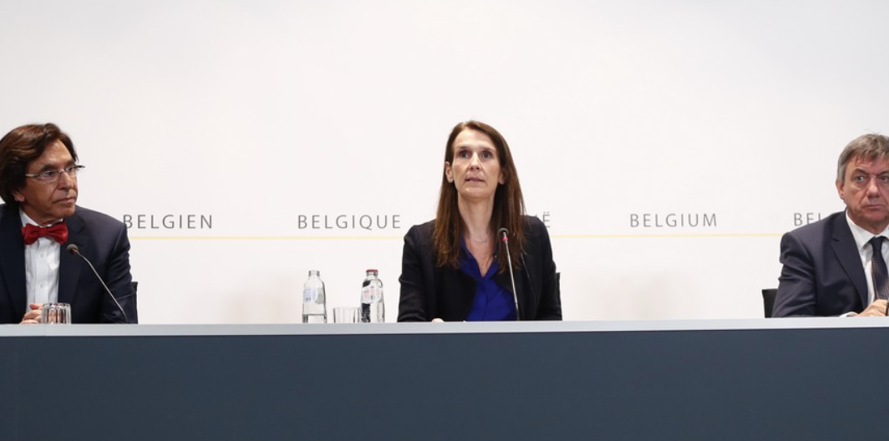
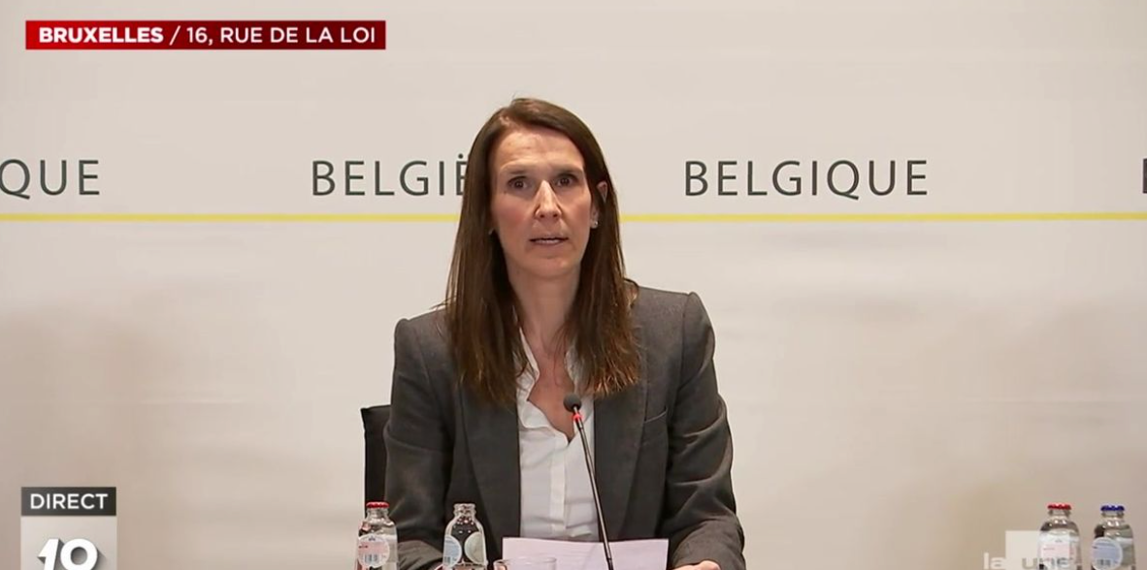
Corpus
6 press conferences announcing the new measures to tackle the COVID-19 pandemic
Held between March 2020 and the beginning of May 2020 (first lockdown)
By the National Security Council (NCS) composed by the former PM Sophie Wilmès and the Minister-Presidents of the federated entities
Rtbf.be ; https://www.rtbf.be/article/crise-du-coronavirus-sophie-wilmes-la-premiere-qui-rassure-10461592
https://bx1.be/dossiers/coronavirus/conseil-national-de-securite-suivez-la-conference-de-presse-de-sophie-wilmes-en-direct-video/

Slide 9
Combining the DHA analytical strategies with temporal ressources of Narrative Analysis (1)
« Tonight, we have decided to take a number of additional measures.
First, inform you that from a public health point of view, we remain in phase 2. Phase 2, as we have already explained to you several times, is the phase in which we are trying to contain the spread and multiplication of the virus in our country.
This objective remains full and complete. »
Sophie Wilmès (12/03/2020) – translated from French
Perspectivization Strategy: positioning of the speaker through diectics (Reisigl & Wodak, 2015) pointing to the time and situation (De Fina, 2003).
Nomination Strategy: « phase 2 » is an artificially created event of timing synchronized with a natural event (Van Leeuwen, 2005).
Intensification Strategy: « remains », « as explained to you several times ». Actualisation of the past in the present (Nahon-Serfaty, 2015)

Slide 10
Our individual and collective efforts have enabled us to achieve our first objective.
Slowing the spread of the virus to prevent the saturation of our hospital services, in order to save as many lives as possible - this is what we ask of you on a daily basis, and it's an arduous task, but it was the measure of the exceptional situation we are experiencing in Belgium and around the world. Not since the Second World War has our country gone through such big test. And yet we are coming to terms with it, little by little, every day. (…)
Our situation continues to be assessed at every moment. Next week, we will be organising a new National Security Council, the aim of which will be to draw up a more detailed plan for the next stage, the transition out of lockdown. Our aim? To organise a progressive transition.
Sophie Wilmès (15/04/2020) – translated from French
Combining the DHA analytical strategies w/ temporal ressources of Narrative Analysis (2)
Intensification Strategy: evaluative attribution of the period as being ‘exceptional’, making a disruption in the ongoing temporality (Chateauraynaud & Doury, 2010).
Predication Strategy & Argumentation Strategy: Comparison with the Second World War, relying on collective memory (Doury & Naccuchio, 2019; De Fina, 2003). & Comparative argument relying on the past (Doury & Nacucchio, 2019; Chateauraynaud & Doury, 2013)
Predication strategy: Discursive qualification of the transition out of lockdown as happening gradually. Time summon (Van Leeuwen, 2005)

Slide 11
Combining the DHA analytical strategies with temporal ressources of Narrative Analysis (3)
"The context is constantly changing, and that's why we've always talked about an evolutionary process. Scientific knowledge is also evolving. We know a lot more about the virus today than we did at the start of the crisis, and that's why we've adapted to each upturn.
(…)
As a political decision-maker, we need time and hindsight to take the necessary measures. And I know that this doesn't fit in with the sense of urgency or immediacy of our world, or that of social media, yet we need to take the time we need to make decisions (...)".
Sophie Wilmès, 06/05/2020 – translated from French
Predication & Intensification Strategy: depiction of context as constantly changing, being a disorienting experience (De Fina, 2003)
Argumentation Strategy: measures taken by decision makers depend on the evolution of scientific knowledge. A causal link is created (Doury & Nacucchio, 2019).
Predication Strategy: political decision-making is described as needing time and is opposed to the immediacy of the world we live in. There is a construction of the timing of political action in comparison with the rest.

Slide 12
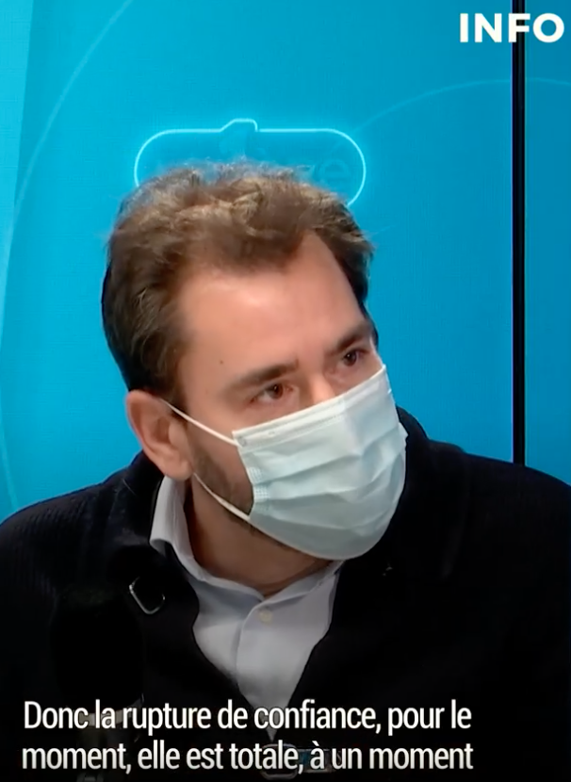
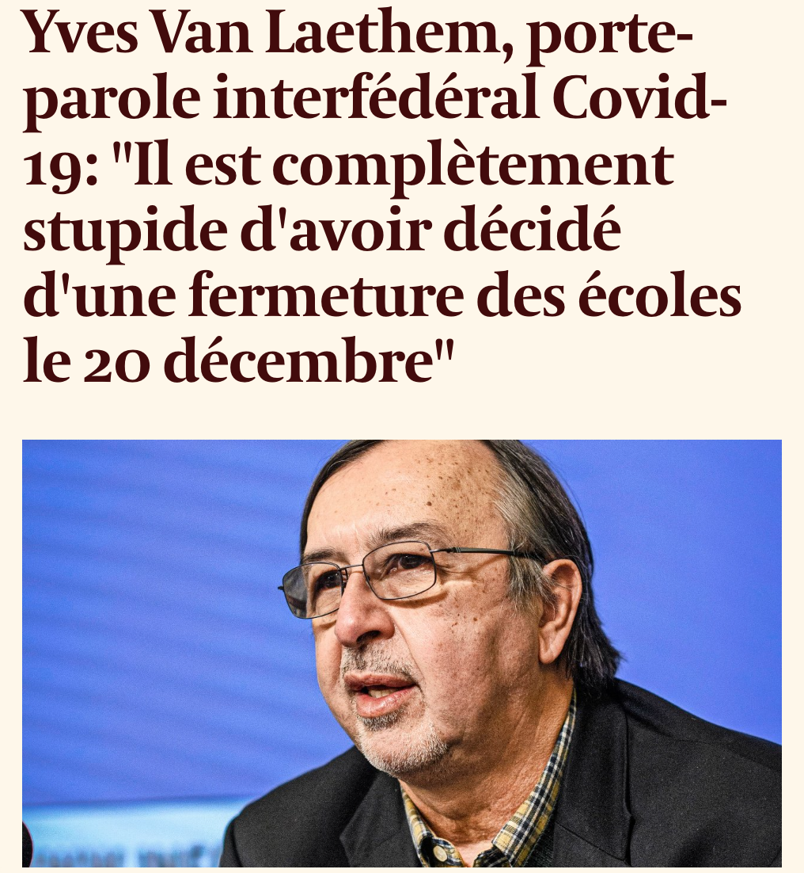
What about the experts?
"The breach of trust is complete. It’s complete at a time when we need trust because Omicron is at our doorstep (...) I'm moved because I don't think they realise. I don't think they realise the political horse-trading that goes on in Codeco.
Marius Gilbert, 23/12/21 – Translated from French (RTBF interview)

Slide 13
Conclusion
Different actors convey different experiences of time
Legitimation / Delegitimation through the discourses on time and their evolution
Of experts (Van Leeuwen, 2007)
Of politicians (on COVID-19 see Wodak, 2022; Raupp, 2022)
Appropriation of each other discourses, some sort of « war of position » (Filiminov & Carpentier, 2022; Mouffe, 1979/2014)
Knowledgeability (>< Opinions) as the principal characteristic of expert positioning (Carpentier, 2011:190-191; Van Leeuwen, 2007:94)
Through various temporal discursive resources: collective memory, narratives, projection in the future, references to the past, etc.
“The temporal dimension of discourse (...) permeates texts and speeches (...) it is an important component of certain discourses, and of political discourse in particular, because of the role it plays in shaping the discursive identity of speakers, their ethos.”
(Doury & Naccuchio, 2019)

Slide 14
References
Boin, A., McConnell, A., ‘t Hart, P., (2021). Governing the Pandemic The Politics of Navigating a Mega-Crisis (Palgrave Ed.)
Boin, A., Sanneke, K., Overdijk, W. (2013). Leadership in times of crisis: a framework for assessment. International Review of Public Administration, 18 (1), 10.1080/12294659.2013.10805241
Carcassonne, M., & Servel, L. (2009). Dire le temps, dire le changement : Analyse socio-discursive de mises en mots de la temporalité dans une organisation en mouvement. Temporalités, 10. https://doi.org/10.4000/temporalites.1122
Carpentier, N. (2011). Media and participation : A site of ideological-democratic struggle. Intellect.
Chateauraynaud, F., & Doury, M. (2010). “Désormais…” Essai sur les fonctions argumentatives d’un marqueur de rupture temporelle. Argumentation et Analyse du Discours, 4, Article 4. https://doi.org/10.4000/aad.772
De Fina, A. (2003). Crossing borders : Time, space, and disorientation in narrative. Narrative Inquiry, 13(2), 367‑391. https://doi.org/10.1075/ni.13.2.08def
De Fina, A. (2022). Stance-taking towards chronotopes as a window into people’s reactions to societal crises : Balcony performances in Italy’s lockdown. Language, Culture and Society, 4(2), 218‑241. https://doi.org/10.1075/lcs.22006.def
De Fina, A. (2008). Who tells which story and why? Micro and macro contexts in narrative. Text & Talk, 28(3). https://doi.org/10.1515/TEXT.2008.020
Doury, M., & Nacucchio, A. (2019). Rhétorique, argumentation et temporalité. Studii de Lingvistică. https://www.academia.edu/39712913/Rh%C3%A9torique_argumentation_et_temporalit%C3%A9
Driessens, O. (2023). Not everything is changing : On the relative neglect and meanings of continuity in communication and social change research. Communication Theory, 33(1), 32‑41. https://doi.org/10.1093/ct/qtac022

Slide 15
References
Forchtner, B. (2021). Introducing ‘Narrative in Critical Discourse Studies’. Critical Discourse Studies, 18(3), 304‑313. https://doi.org/10.1080/17405904.2020.1802765
Harrison, M., Lancaster, K., & Rhodes, T. (2022). “A matter of time” : Evidence-making temporalities of vaccine development in the COVID-19 media landscape. Time & Society, 31(1), 132‑154. https://doi.org/10.1177/0961463X211032201
McKibben, E. & Breheny, M. (2023). Making Sense of Making Sense of Time: Longitudinal Narrative Research. International Journal of Qualitative Methods, 22, https://doi.org/10.1177/16094069231160928
Nahon-Serfaty, I. (2015). Le temps dans une herméneutique du discours sanitaire. Revue française des sciences de l’information et de la communication, 6. https://doi.org/10.4000/rfsic.1342
Raupp, J. (2022). “TheSituationIsSerious”: AngelaMerkel’s Crisis Communication in the COVID-19 Pandemic. In: Maarek (dir.), Manufacturing Government Communication on Covid-19 (Springer, Ed.)
Reisigl, M. (2017). The discourse historical approach. In The Routledge Handbook of Critical Discourse Studies (Routledge).
Reisigl, M., & Wodak, R. (2016). The discourse historical approach (DHA). In Methods of critical discourse studies 3rd edition (Sage, p. 23‑61). Sage.
Ricoeur, Paul. (1983). Temps et récit I (Editions du Seuil).
Van Leeuwen, T. (2005). Time in discourse. Linguistics and Human Sciences 1(1), 127-145, issn 1743–1662
Wodak, R. (2015). Critical Discourse Analysis, Discourse-Historical Approach (p. 14pp). https://doi.org/10.4135/9780857028020.d6
Wodak, R. (2022). Legitimizing Crisis Management during COVID-191. Argumentation et Analyse Du Discours, 28. https://doi.org/10.4000/aad.6483

Slide 16
Focus and research questions (2)
Research questions:
In what ways time and temporality are expressed by experts and politicians in their respective discourses?
In what ways did the discourse on time evolve over the duration of the crisis?
In what ways do the scientific and political discourses on time interfere/collide/complement (with) each other over the duration of the crisis?
In what ways are the discourses on time producing power relationships between experts and politicians as part of the decision-making process about sanitary measures?
The overarching research question:
How did the scientific and political discourses on time evolve and relate to each other as part of the decision-making process about sanitary measures during the COVID-19 pandemic in Belgium?

